Slide 1
Heat Calculations (pg 25 w/s)
5000 J
21000 J
1840 J
0.21 cal/g◦C
10 ◦C

Slide 2
Energy Transformations in Illustrations

Slide 3
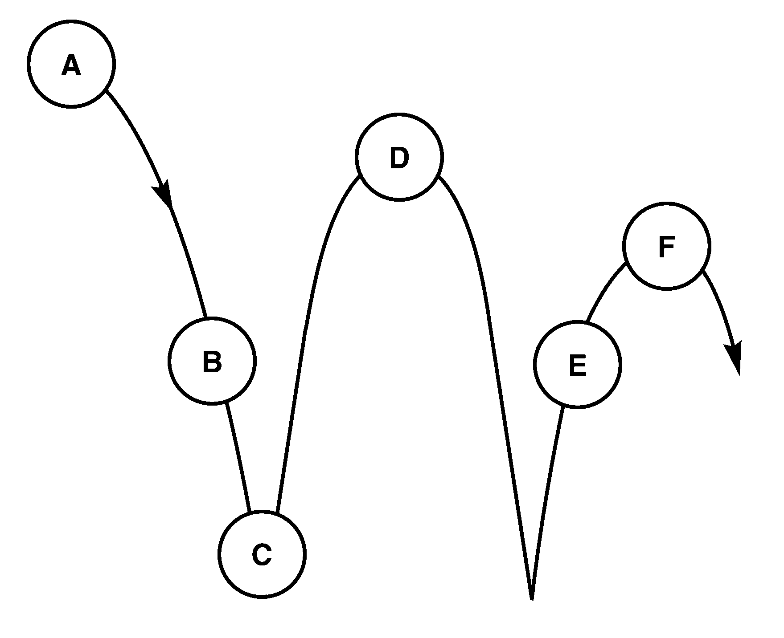
Bouncing Ball
When dropping a ball it travels the following path where is the
  Kinetic energy is decreasing
  Kinetic energy is increasing
  Kinetic energy is the HIGHEST
  Kinetic energy is the LOWEST
  Potential energy is decreasing
  Potential energy is increasing
  Potential energy is the HIGHEST
  Potential energy is the LOWEST
  Both KE and PE present

Slide 4
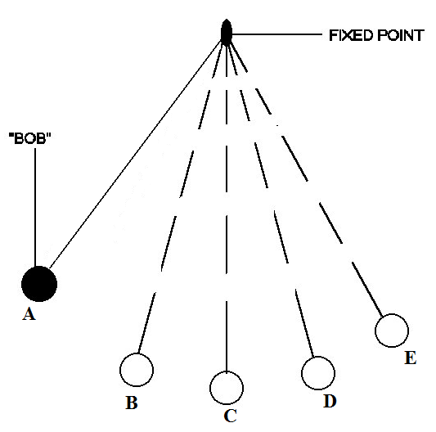
Pendulum
A pendulum travels the following path where is the
  Kinetic energy is decreasing
  Kinetic energy is increasing
  Kinetic energy is the HIGHEST
  Kinetic energy is the LOWEST
  Potential energy is decreasing
  Potential energy is increasing
  Potential energy is the HIGHEST
  Potential energy is the LOWEST
  Both KE and PE present

Slide 5
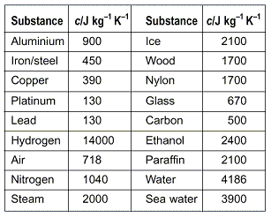
Reading Specific Heat Tables
Recall specific heat tells you how much energy is needed to increase the temperature of 1 gram by 1 degree.
  What substance takes the most energy to heat?
  What substance take the least energy to heat?
  What two substances listed make good conductors?
  What two substances make good insulators?

Slide 6
Temperature Conversation
K = °C + 273
°F = (9/5x °C) +32 °C = 5/9(°F-32)
Convert 58 °C to K
Convert 58 °C to °F
Convert 358 K to °C

Slide 7
K = °C + 273
°F = (9/5x °C) +32 °C = 5/9(°F-32)
Kinetic Energy =1/2 (mass x velocity²)
KE = ½ m v²
Potential Energy = mass x gravity x height
PE = m g h
g = 9.8 m/s²
Heat = mass x specific heat x change in temp
Q = m c Δt

Slide 8
Ch 15 | Ch 16
PE=4312 J KE=10J V=9 m/s KE=100 J KE= 1960 J KE= 2240 J PE = 2058 J PE = 3528 J | Tf=58.86 C c = 383.88 j/kgK 51) Q=47145 J 53)C = 272.5 J/kgK 54) Q=140.22 kJ

